Slide 1
Species and trophic dynamics

Slide 2
What is the purpose of a food web?

Slide 3
Who controls these interactions?

Slide 4
Bottom up controls

Slide 5
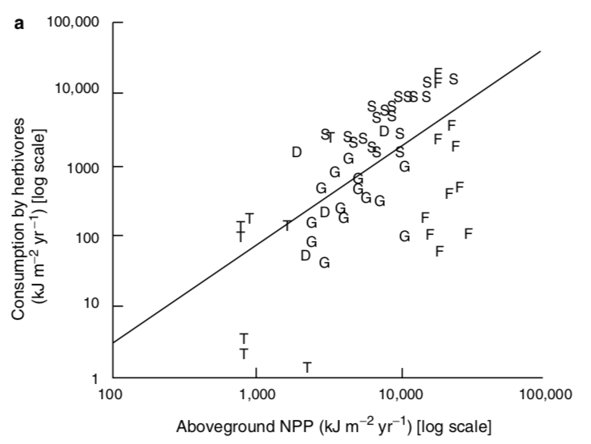
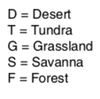
Herbivory increases with NPP

Slide 6
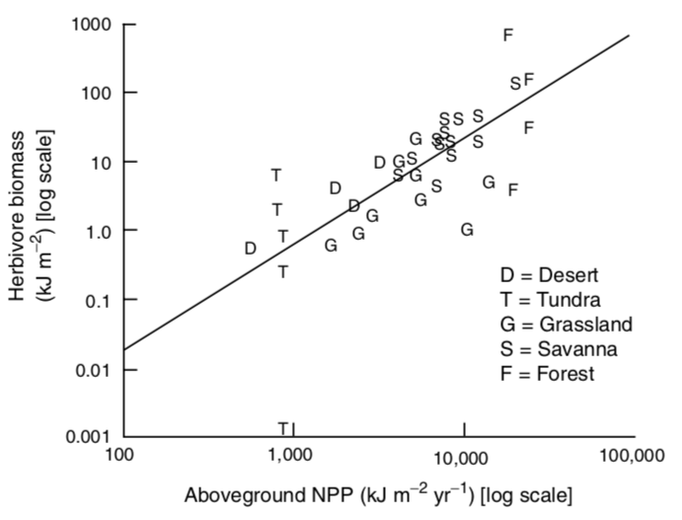
Herbivore biomass increases with NPP

Slide 7
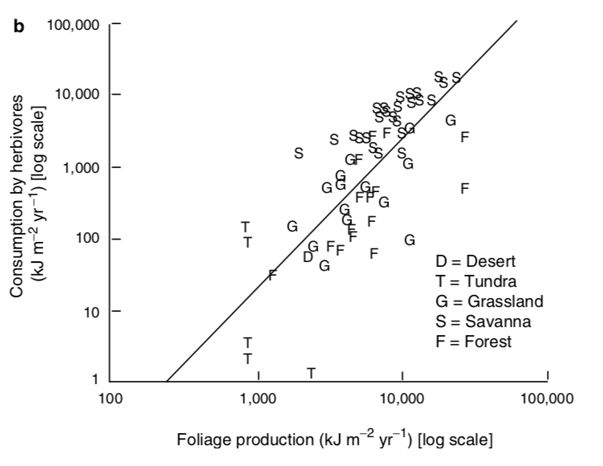
Actually driven by leaf production
Why?

Slide 8
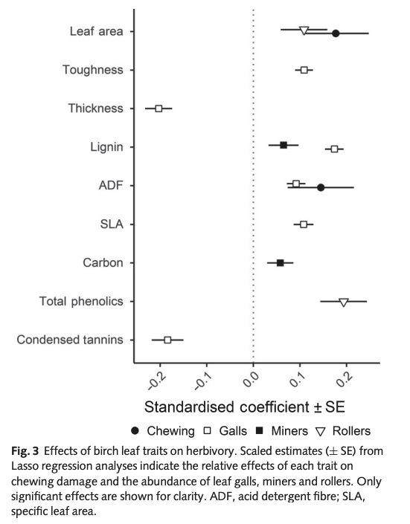
Leaf traits influence herbivory
Muiruri et al. (2019) New Phytologist

Slide 9
Why do we care about anything other than plants and microbes?
Dominate energy (>95%) and nutrient transfer in terrestrial ecosystems
NPP uncertainty is greater than energy transfer from plants to animals

Slide 10
Leaf traits influence herbivory
Muiruri et al. (2019) New Phytologist

Slide 11
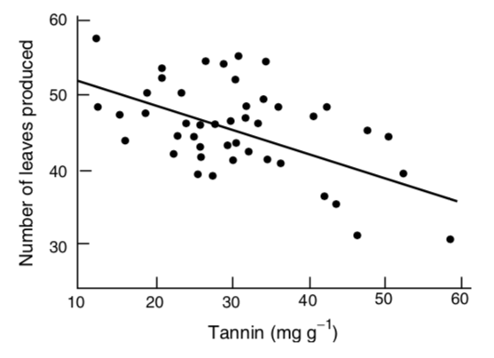
Trade-off between herbivory protection and leaf productivity

Slide 12
Trade-off between herbivory protection and leaf productivity
So maybe plants aren’t fully driving these interactions!

Slide 13
Top down controls

Slide 14
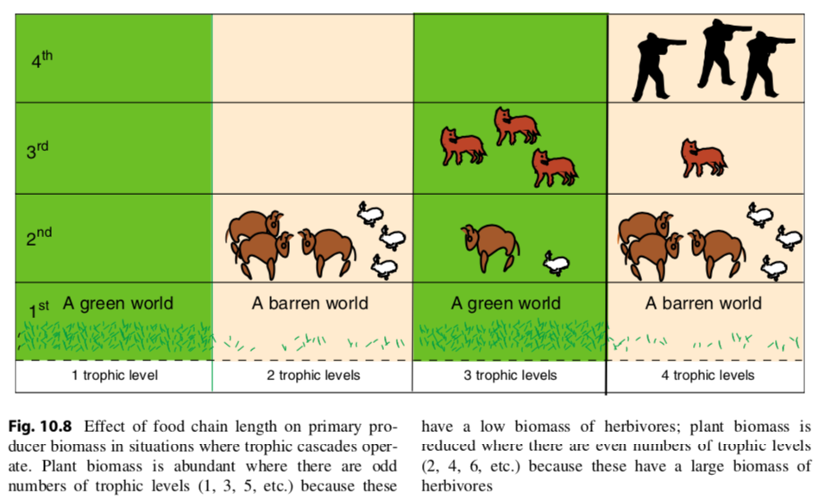

Slide 15
What types of organisms exert the strongest top-down controls?

Slide 16
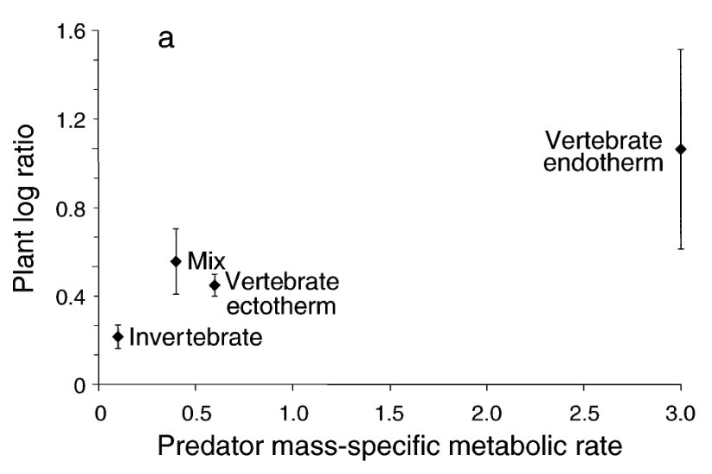
Top-down control strength
Borer et al. (2005)
Notes:
Endotherm (internal heat), ectotherm (external heat)

Slide 17
Energy flow through trophic levels

Slide 18
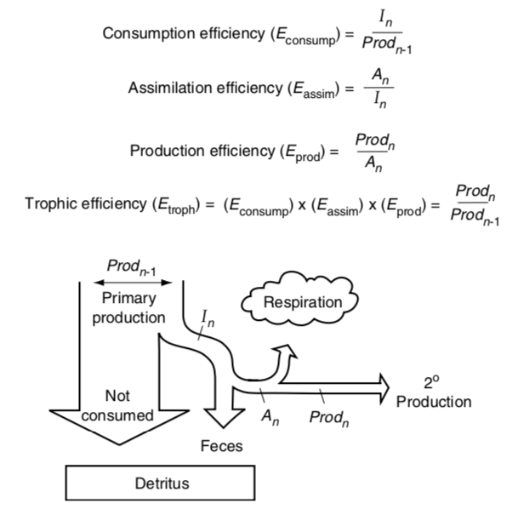

Slide 19
Percent production by lower trophic level that is consumed by the higher trophic level

Slide 20
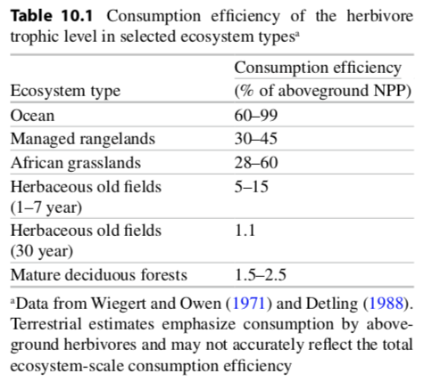

Slide 21
The amount consumed that is assimilated into the organism (not pooped out)

Slide 22
Carnivores have 4x greater assimilation efficiencies than herbivores. Why?

Slide 23
The amount assimilated that is not respired

Slide 24
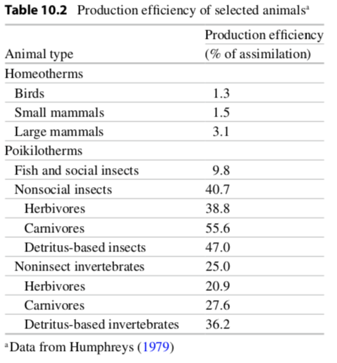
Notes:
Homeotherm (same temp), poikilotherm (variable temp)

Slide 25
Efficiency of the trophic level

Slide 26
Activity: what is the largest food chain you can create?
Notes:
To determine what controls food chain length

Slide 27
Activity: what is the largest food chain you can create?
What is characteristic about the longest ones?
Notes:
To determine what controls food chain length

Slide 28
How does nutrient and energy flow differ?

Slide 29
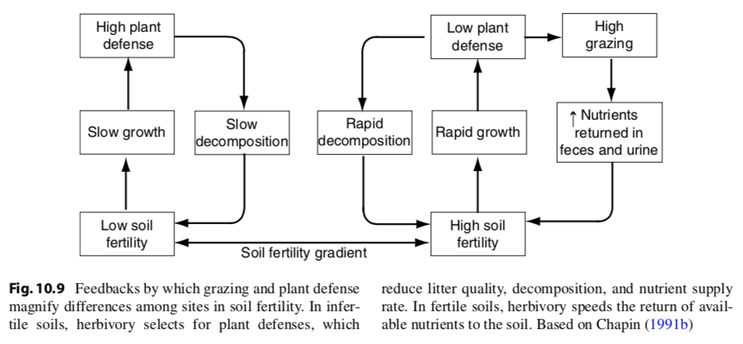
Herbivores speed nutrient flow

Slide 30
Species-level impacts

Slide 31
Some species have larger impacts on ecosystem processes than others. Agree/disagree? Why?

Slide 32
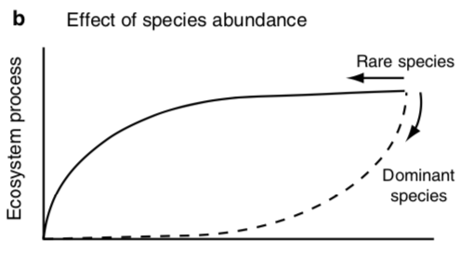
Dominant species drive ecosystem processes
Species Richness

Slide 33
Effect might be dependent on time
Process difference from control
Years since dominant species removal
Read et al. (2017)

Slide 34
Effect might be dependent on time
Community is filling the niche of the dominant species
Process difference from control
Years since dominant species removal
Read et al. (2017)

Slide 35
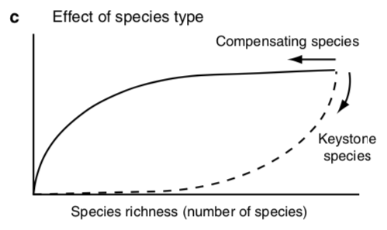
Keystone species drive ecosystem processes
Ecosystem process

Slide 36
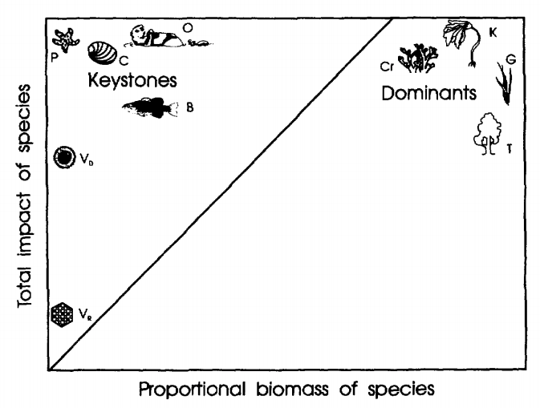
Keystones have importance that outweighs abundance
Power et al. (1996)

Slide 37
Functional types

Slide 38
Functional types describe the life history strategy of a species…
Broadleaf tree
Needleleaf tree
Deciduous tree
Shrub
Grass

Slide 39
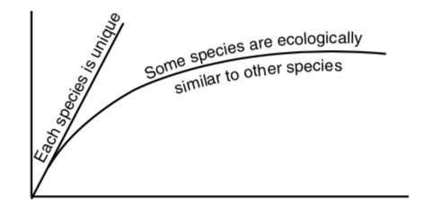
…and this can influence ecosystem processes…
Ecosystem Process
Number of species

Slide 40
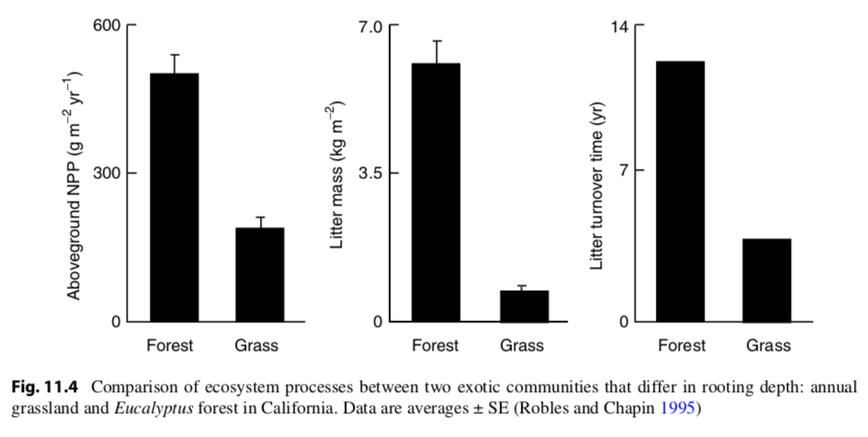
…such as biomass…

Slide 41
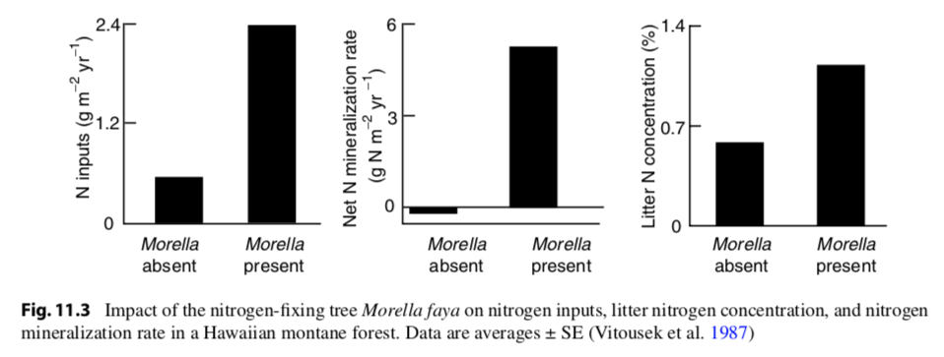
…nutrient supply…

Slide 42
…nutrient turnover…

Slide 43
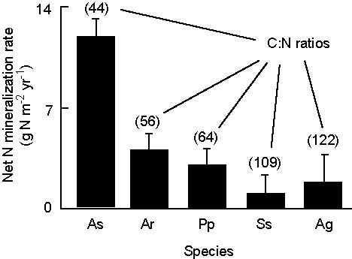
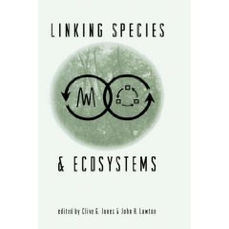
…nutrient turnover…
(Jones & Lawton 1995)

Slide 44
…nutrient turnover…
(Jones & Lawton 1995)

Slide 45
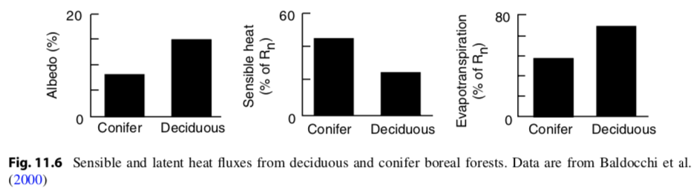
…biophysics…

Slide 46
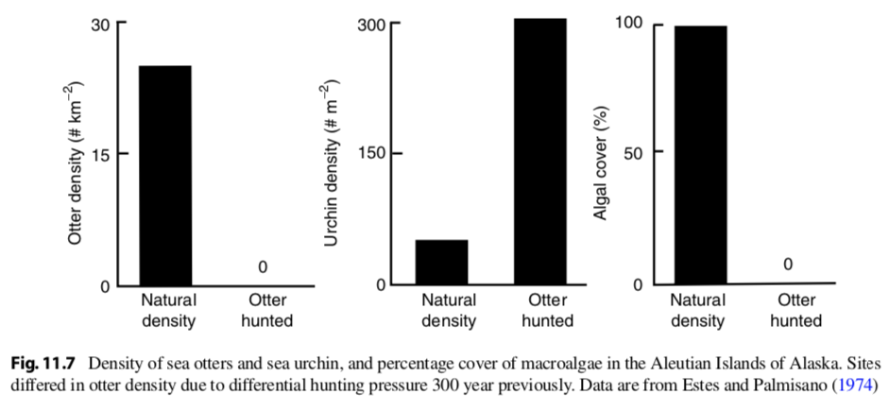
…trophic dynamics…

Slide 47
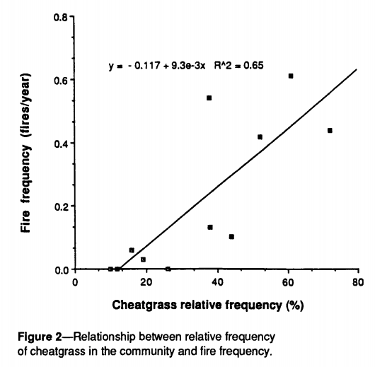
…and disturbance regimes
Bromus tectorum (cheatgrass)
Sagebrush steppe
Whisenant (1989)

Slide 48
Biodiversity

Slide 49
Biodiversity – some definitions
Richness (R): total number of species in a given area
Evenness (E): relative abundance of the species present
Species diversity (D): a combination of richness and evenness (D = R * E)
Larger if more species
Larger if species are evenly distributed

Slide 50
 | Community A | Community B
Species 1 | 5 | 10
Species 2 | 60 | 10
Species 3 | 0 | 10
Which community has higher richness?
Which community has higher evenness?
Which community has greater diversity?

Slide 51
 | Community A | Community B
Species 1 | 5 | 10
Species 2 | 5 | 10
Species 3 | 0 | 10
Which community has higher richness?
Which community has higher evenness?
Which community has greater diversity?

Slide 52
How does diversity influence ecosystem services?

Slide 53
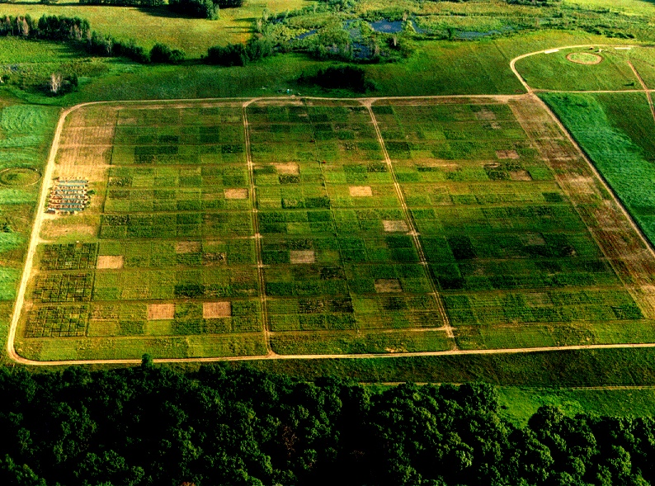

Slide 54
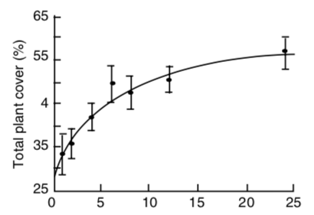
Species richness
Tilman et al. (1996)

Slide 55
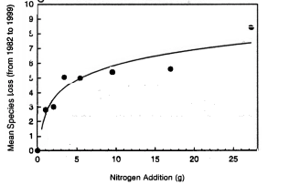
Threats to biodiversity: Eutrophication
Competition can increase biodiversity
Eutrophication is the increase of nutrients to natural ecosystems
Reduces competition
Enhances the dominance of a few species
N addition causes species loss in Minnesota (Tilmann et al. (1994))

Slide 56
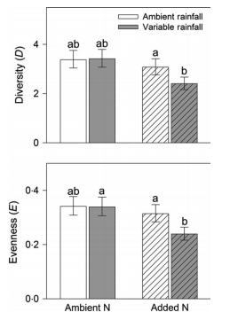
Threats to biodiversity: Eutrophication
Smith et al. (2016)

Slide 57
Threats to biodiversity: Invasive species
Sometimes the competitors are too good, and biodiversity decreases
Invasive species possess traits that native species do not have
Enhanced tolerance
Fast reproduction
No predators
No competitors
Diversity decreases invasion, invasion decreases diversity
Kudzu in SW US

Slide 58
Take home: to fully understand ecosystem processes, we need to understand the underlying species level processes

